Slide 1


Horngren’s Financial & Managerial Accounting
Seventh Edition
Chapter 2
Recording Business Transactions
Copyright © 2021 Pearson Education, Inc. All Rights Reserved
Notes:
If this PowerPoint presentation contains mathematical equations, you may need to check that your computer has the following installed:
1) MathType Plugin
2) Math Player (free versions available)
3) NVDA Reader (free versions available)

Slide 2

Chapter 2 Learning Objectives (1 of 2)
2.1 Explain accounts as they relate to the accounting equation and describe common accounts
2.2 Define debits, credits, and normal account balances using double-entry accounting and T-accounts
2.3 Record transactions in a journal and post journal entries to the ledger

Slide 3
Chapter 2 Learning Objectives (2 of 2)
2.4 Prepare the trial balance and illustrate how to use the trial balance to prepare financial statements
2.5 Use the debt ratio to evaluate business performance

Slide 4

Learning Objective 2.1
Explain accounts as they relate to the accounting equation and describe common accounts

Slide 5
What Is an Account?
The accounting equation contains three categories: assets, liabilities, and equity. Each part contains accounts.
An account is the detailed record of all increases and decreases that have occurred in an account during a specified period.
Notes:
The accounting equation is the basic tool of accounting. The accounting equation is made up of three categories: assets, liabilities, and equity. Each category contains accounts, which are detailed records of all increases and decreases that have occurred in an individual asset, liability, or equity during a specific period.

Slide 6
Assets
Exhibit F:2-1 Asset Accounts
Account Name | Explanation
Cash | A business’s money. Includes bank balances, bills, coins, and checks.
Accounts Receivable | A customer’s promise to pay in the future for services or goods sold. Often described as “On Account.”
Notes Receivable | A written promise that a customer will pay a fixed amount of money (principal) and interest by a certain date in the future. Usually more formal than an Accounts Receivable.
Prepaid Expense | A payment of an expense in advance. It is considered an asset because the prepayment provides a benefit in the future. Examples of prepaid expenses are Prepaid Rent, Prepaid Insurance, and Office Supplies.
Land | The cost of land a business uses in operations.
Building | The cost of an office building, a store, or a warehouse.
Equipment, Furniture, and Fixtures | The cost of equipment, furniture, and fixtures (such as light fixtures and shelving). A business has a separate asset account for each type.
Notes:
Assets are something the business owns or has control of that has value. Assets are economic resources that are expected to benefit the business in the future. Many examples were introduced in Chapter 1, such as Cash, Accounts Receivable, Equipment, Building, and Land. Accounts Receivable represent a customer’s promise to pay monies in the future for services or goods already provided. Equipment, Furniture, Fixtures, and Land are assets used by businesses in operations.
Two new assets introduced are Notes Receivable and Prepaid Expenses. Notes Receivable represents a promise by a customer to pay a fixed amount of money along with interest on a specific date. Generally, Notes Receivable require a formal promissory note which includes a stated interest rate.
Prepaid Expenses are expenses paid in advance that are expected to benefit the business in the future. Examples of Prepaid Expenses include Prepaid Rent, Prepaid Insurance, and Office Supplies.

Slide 7
Liabilities
Exhibit F:2-2 Liability Accounts
Account Name | Explanation
Accounts Payable | A promise made by the business to pay a debt in the future. Arises from a credit purchase.
Notes Payable | A written promise made by the business to pay a debt, usually involving interest, in the future.
Accrued Liability | An amount owed but not paid. A specific type of payable such as Taxes Payable, Rent Payable, and Salaries Payable.
Unearned Revenue | Occurs when a company receives cash from a customer but has not provided the product or service. The promise to provide services or deliver goods in the future.
Notes:
A liability is a debt, something that the business owes. A business generally has fewer liabilities than asset accounts. A payable involves a future payment of cash.
A note payable is a written promise made by the business to pay a liability in the future and generally includes interest. An accrued liability is an amount owed for goods or services provided but not yet paid by the business. Unearned revenue occurs when a company receives cash from a customer before the business provides the goods or services.

Slide 8
Equity
Exhibit F:2-3 Equity Accounts
Account Name | Explanation
Common Stock | Represents the net contributions of the stockholders in the business. Increases equity.
Dividends | Distributions of cash or other assets to the stockholders. Decreases equity.
Revenues | Earnings that result from delivering goods or services to customers. Increases equity. Examples include Service Revenue and Rent Revenue.
Expenses | The cost of selling goods or services. Decreases equity. Examples include Rent Expense, Salaries Expense, and Utilities Expense.
Notes:
The stockholders’ claim to the assets of the business is called equity or stockholders’ equity. A company has separate accounts for each element of equity. Equity is increased for Common Stock and Revenues and decreased for Dividends and Expenses.

Slide 9
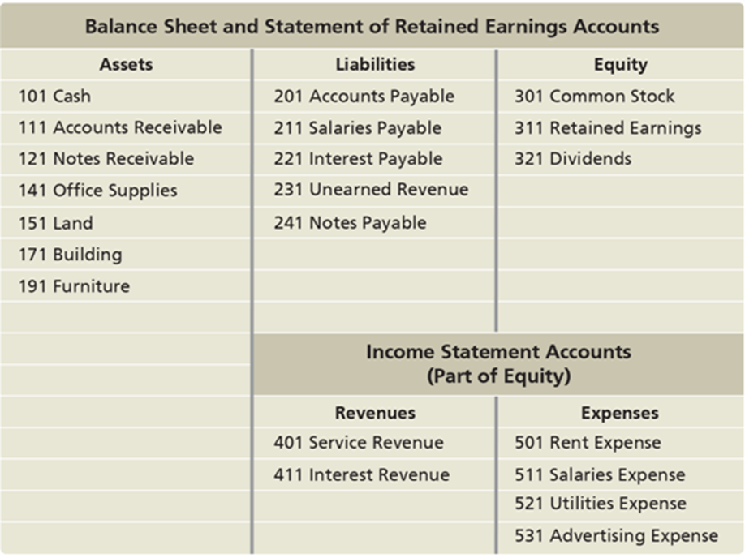
Chart of Accounts
A chart of accounts is used to organize a company’s accounts.
A ledger is a record holding all the accounts of a business, the changes in those accounts, and their balances.
Exhibit F:2-4 Chart of Accounts—Smart Touch Learning
Notes:
Exhibit F:2-4 shows the chart of accounts for Smart Touch Learning. A chart of accounts is used to organize a company’s accounts. A chart of accounts lists all company accounts along with the account numbers. Account numbers are just shorthand versions of the account names. Each account has an individual account number, similar to how Social Security numbers are unique to each of us. The chart of accounts varies from business to business, though most account names are common to all companies.
In addition to a chart of accounts, companies need a way to show all of the increases and decreases in each account along with their balances. A ledger is used to complete this task. A ledger is a collection of all the accounts, the changes in those accounts, and their balances. A ledger provides more detail than a chart of accounts.
Balance Sheet Account, Assets: 101, cash; 111, Accounts Receivable; 121, Notes receivable; 141, Office supplies; 151, Furniture; 171, Building; 191, Land. Balance Sheet Account, Liabilities: 201, Accounts Payable; 211, Salaries payable; 221, Interest payable; 231, Unearned Revenue; 241, Notes Payable. Balance Sheet Account, Equity: 301, Common Stock; 311, Retained Earnings; 321 Dividends. Income statement Account (Part of Equity), Revenues: 401, Service Revenue; 411, Interest Revenue. Income Statement Account (Part of Equity), Expenses: 501, Rent Expense; 511, Salaries Expense; 521, Utilities Expense; 531, Advertising Expense.

Slide 10
Data Analytics in Accounting
The number of accounts in a company’s chart of accounts depends on its size, complexity, number of locations, and activities.
The chart of accounts can be used to:
process transactions and business activities
analyze accounting data
compare prior period amounts to current year
identify errors
track changes in accounts
Notes:
Companies should strive to have as small of a chart of accounts as possible because the more accounts a company has the more potential problems that can occur, including difficulty in reconciliations and reporting errors. A recent survey from the APQC (American Productivity & Quality Center) showed that on average companies have 450 different accounts in their chart of accounts.

Slide 11
Learning Objective 2.2
Define debits, credits, and normal account balances using double-entry accounting and T-accounts

Slide 12
What Is Double-Entry Accounting?
Transactions always involve at least two accounts.
Accounting uses the double-entry system to record the dual effects of each transaction.
For example, office supplies are purchased for cash requiring an increase in Office Supplies and a decrease in Cash.
Notes:
In accounting, the double-entry system is used to record the dual effects of every transaction. A transaction would be incomplete if only one side of the transaction were recorded. In addition, recording only one side of the transaction leaves the accounting equation out of balance.

Slide 13
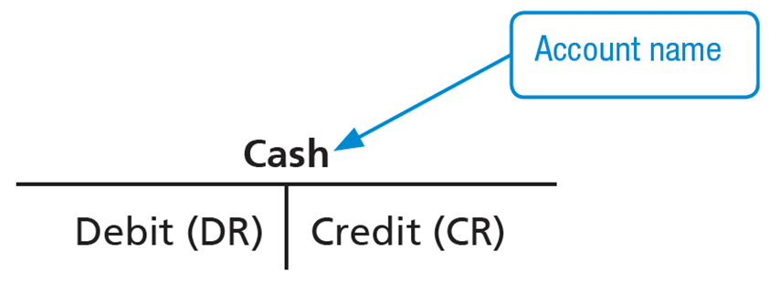
The T-Account
A shortened form of the ledger is called the T-account.
The left side of the T-account is called the debit.
The right side of the T-account is called a credit.
Notes:
A T-account is a shortened form of the ledger and is called a T-account because it resembles a capital T. The name of the account is listed on top of the T. The left and right sides of the T-account are used to record increases and decreases in the account. Debit is abbreviated as DR, and credit is abbreviated as CR.

Slide 14
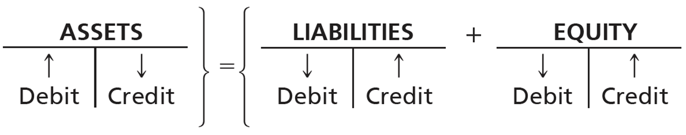
Increases and Decreases in the Accounts (1 of 2)
How we record increases and decreases to an account is determined by the account type.
Notes:
Increases and decreases to an account are determined by the type of account: asset, liability, or equity. Depending on the type of account, increases are recorded on one side, and decreases are recorded on the opposite side. Assets are always increased with a debit and decreased with a credit. Liabilities and equity are always increased with a credit and decreased with a debit. Debits are not always increases or always decreases, and neither are credits. The debit or credit designates on which side of the T-account the transaction is recorded.

Slide 15
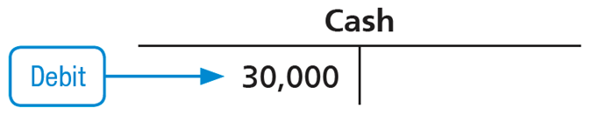
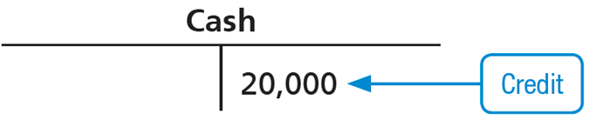
Increases and Decreases in the Accounts (2 of 2)
To increase the Cash account, a business would record a debit to Cash.
To decrease the Cash account, a business would record a credit to Cash.
Notes:
Assume a business wants to record an increase of $30,000 to the Cash account. They would record a debit to Cash of $30,000.
If the business, instead, wanted to record a decrease of $20,000 to the Cash account they would record a credit to Cash.

Slide 16
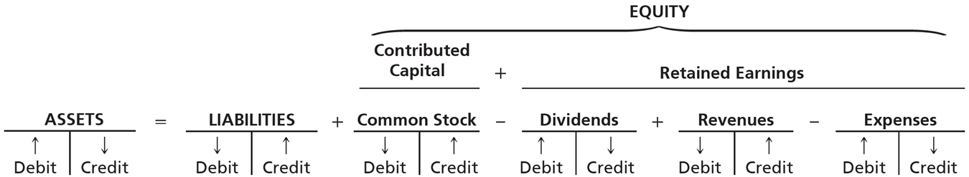
Expanding the Rules of Debit and Credit
The accounting equation is expanded to include the rules of debits and credits for the elements of equity:
Notes:
The accounting equation is expanded to include the four types of equity accounts: Common Stock, Dividends, Revenues, and Expenses. Common Stock and Revenue both increase Equity, but Dividends and Expense accounts increase with a debit, which results in a decrease in equity.
Assets = liabilities + equity.
Assets: Debit = increase, credit = decrease.
Liabilities: Debit = decrease, credit = increase.
Equity = contributed capital + retained earnings.
• Contributed capital is common stock with debit = decrease, credit = increase.
• Retained earnings = negative dividends + revenues minus expenses. Dividends: Debit = increase, credit = decrease. Revenues: Debit = decrease, credit = increase. Expenses: Debit = increase, credit = decrease.

Slide 17
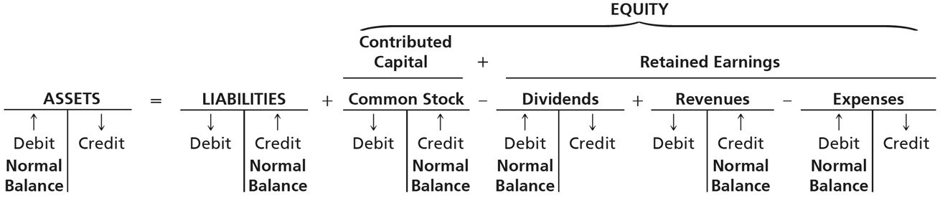
The Normal Balance of an Account (1 of 2)
All accounts are summarized on one side of the T-account, called the normal balance.
An account’s normal balance appears on the increase side of the account.
Assets increase with a debit, so the normal balance is a debit.
Liabilities and equity increase with a credit, so the normal balance is a credit.
Notes:
All accounts have a normal balance. An account’s normal balance is on the side of the account that increases the account. Assets, Dividends, and Expenses are increased with a debit; therefore, the normal balance for these accounts is a debit. Revenues, Liabilities, and Equity increase with a credit; therefore, the normal balance for these accounts is a credit.
Assets = Liabilities + Equity.
Assets: Debit = increase, normal balance, credit = decrease.
Liabilities: Debit = decrease, credit = increase, normal balance.
Equity = Contributed capital + retained earnings.
• Contributed capital is common stock with debit = decrease, credit = increase, normal balance.
Retained earnings = Negative dividends + revenues minus expenses. Dividends: Debit = increase, normal balance, credit = decrease. Revenues: Debit = decrease, credit = increase, normal balance. Expenses: Debit = increase, normal balance, credit = decrease.

Slide 18
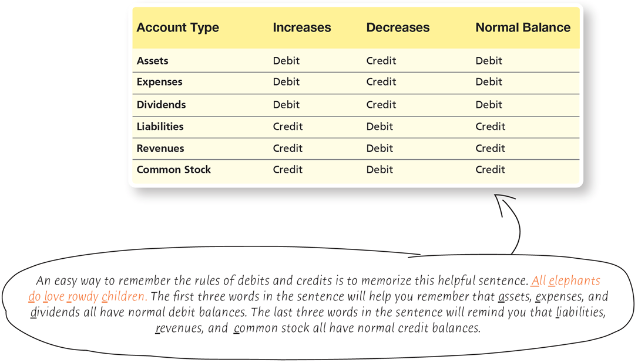
The Normal Balance of an Account (2 of 2)
Exhibit F:2-5 Rules of Debits and Credits and Normal Balances for Each Account Type
Notes:
Exhibit F:2-5 summarizes the normal balances for each type of account. As the table shows, Assets, Expenses, and Dividends all increase with debits and have a normal debit balance. Liabilities, Revenues, and Common Stock increase with a credit and therefore have a normal credit balance.
An easy way to remember the rules of debits and credits is to memorize this helpful sentence: “All Elephants Do Love Rowdy Children”
A table has 6 rows and 4 columns. The columns have the following headings from left to right. Account Type, Increases, Decreases, Normal Balance. The row entries are as follows. Row 1. Account Type, Assets. Increases, Debit. Decreases, Credit. Normal Balance, Debit. Row 2. Account Type, Expenses. Increases, Debit. Decreases, Credit. Normal Balance, Debit. Row 3. Account Type, Dividends. Increases, Debit. Decreases, Credit. Normal Balance, Debit. Row 4. Account Type, Liabilities. Increases, Credit. Decreases, Debit. Normal Balance, Credit. Row 5. Account Type, Revenues. Increases, Credit. Decreases, Debit. Normal Balance, Credit. Row 6. Account Type, Common Stock. Increases, Credit. Decreases, Debit. Normal Balance, Credit.
An easy way to remember the rules of debits and credits is to memorize this helpful sentence. All elephants do love rowdy children. The first three words in the sentence will help you remember that assets, expenses, and dividends all have normal debit balances. The last three words in the sentence will remind you that liabilities, revenues, and common stock all have normal credit balances.

Slide 19
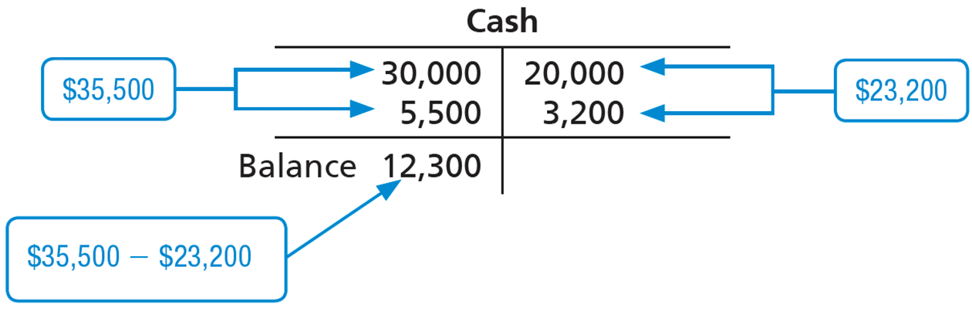
Determining the Balance of a T-Account
Use the T-account to determine the ending balance in an account. The ending balance is shown on the side with the larger number.
Notes:
The T-account is used to obtain a summary, or balance, of a particular account. The summation of the account is reported on the side of the T-account with the larger number. For example, if the total debits for Cash equal $35,500 and the credits are $23,200 the normal balance is $12,300. The total of the credits is subtracted from the total debits to determine the ending balance.

Slide 20
Learning Objective 2.3
Record transactions in a journal and post journal entries to the ledger

Slide 21
How Do You Record Transactions?
Accountants use source documents to provide evidence and data for recording transactions.
The documents help businesses determine how to record the transactions.
Notes:
Source documents provide the information needed by accounts to record accounting transactions. Based on these documents, the business can determine how to record transactions.

Slide 22
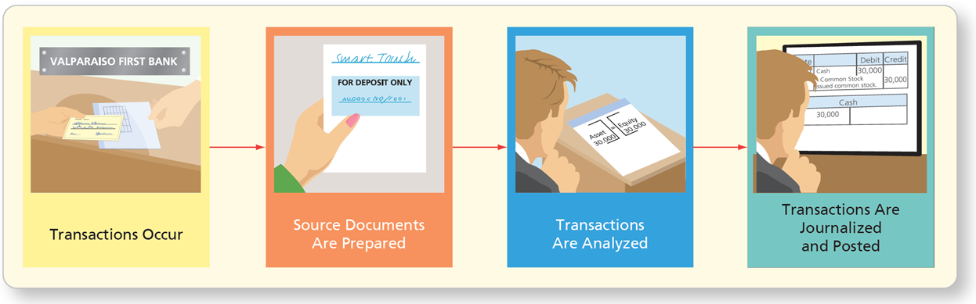
Source Documents—The Origin of the Transactions
Exhibit F:2-6 Flow of Accounting Data
Other source documents used include:
Purchase invoices
Bank checks
Sales invoices
Notes:
After source documents are prepared and transactions are analyzed, the next major step in the recording process is to formally enter the transaction information into the general journal. Essentially, the general journal is a chronological record of each of the transactions, recorded in a standardized format.
Other source documents include:
Purchase invoices, which are documents that tell the business how much and when to pay a vendor for purchases on account, such as office supplies.
Bank checks, which are documents that illustrate the amount and date of cash payments.
Sales invoices, which are documents provided to clients when a business sells services or goods; tells the business how much revenue to record.

Slide 23
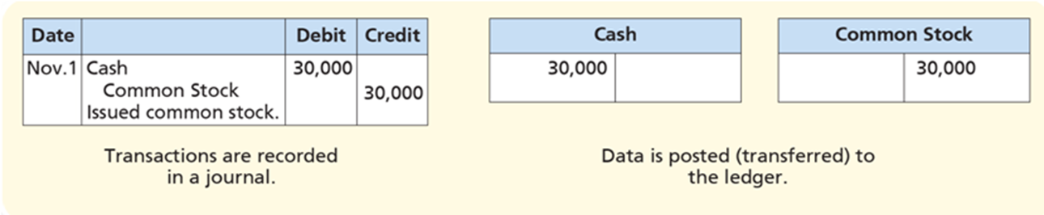
Journalizing and Posting Transactions (1 of 24)
After reviewing source documents, accountants record the transactions.
Transactions are recorded in a journal, the record of the transactions in date order
The data from the journal is then transferred to the ledger, a process called posting.
Notes:
Accountants use the source documents to record transactions in the journal. A journal is a record of the transactions in date order. The journal is not a record holding all of the accounts, so data must be transferred from the journal to the ledger through the posting process.
Date, line 1, November 1. Cash. Debit, 30,000. Line 2, common stock. Credit 30,000. Line 3, issued common stock. Data is posted, or transferred, to the ledger. Ledger. T-account: cash. Line 1, Debit, 30,000. Credit, blank. T-account: common stock. Line 1, Debit, blank. Credit, 30,000.

Slide 24
Journalizing and Posting Transactions (2 of 24)
The journalizing and posting process has five steps:
Step 1: Identify the accounts and the account type (asset, liability, or equity).
Step 2: Decide whether each account increases or decreases, then apply the rules of debits and credits.
Step 3: Record the transaction in the journal.
Step 4: Post the journal entry to the ledger.
Step 5: Determine whether the accounting equation is in balance.
Notes:
You can use a modified version of the steps for analyzing accounting transactions to help when you are recording transactions in the journal and then posting the journal entries to the ledger.

Slide 25
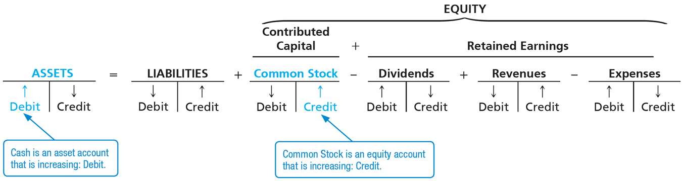
Journalizing and Posting Transactions (3 of 24)
Transaction 1—Stockholder Contribution
On November 1, the e-learning company received $30,000 cash from Sheena Bright, and the business issued common stock to her.
Notes:
In Transaction 1, Smart Touch Learning received cash from Sheena Bright in exchange for common stock of $30,000.
Step 1: The two accounts involved are Cash (Asset) and Common Stock (Equity).
Step 2: Both accounts increase by $30,000. Cash is increased with a debit, and Common Stock is increased with a credit.
Assets (highlighted) = liabilities + equity.
Assets: Debit = highlighted, cash is an asset account that is increasing: debit, credit = decrease.
Liabilities: Debit = decrease, credit = increase.
Equity = contributed capital + retained earnings.
• Contributed capital is common stock (highlighted) which has debit = decrease, credit = highlighted, common stock is an equity account that is increasing: credit.
• Retained earnings = negative dividends + revenues minus expenses. Dividends: Debit = increase, credit = decrease. Revenues: Debit = decrease, credit = increase. Expenses: Debit = increase, credit = decrease.

Slide 26
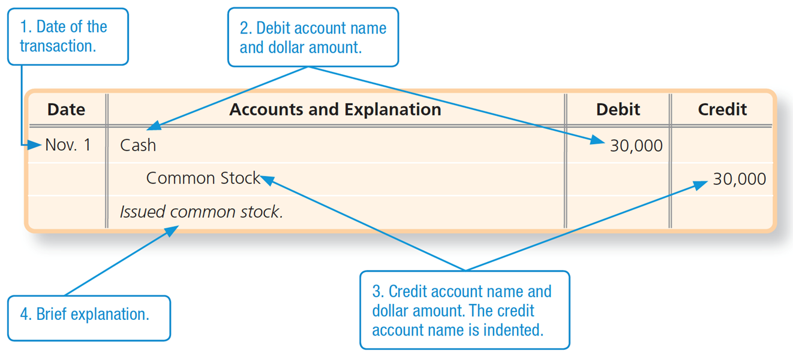
Journalizing and Posting Transactions (4 of 24)
Transaction 1—Stockholder Contribution
Notes:
Step 3: The transaction is recorded in the journal with a journal entry (illustrated on the slide). The journal entry contains four parts: the date of the transaction, the debit account name and dollar amount, the credit account name and dollar amount, and an explanation.
2. Debit account name and dollar amount. 3. Credit account name and dollar amount. The credit account name is indented. 4. A Brief explanation. Transaction 1 is as follows. Date: November 1, line 1. Account debited: Cash. Amount debited: 30,000, line 1. Account credited: Common stock, line 2. Amount credited: 30,000, line 2. Explanation: Issued common stock.

Slide 27
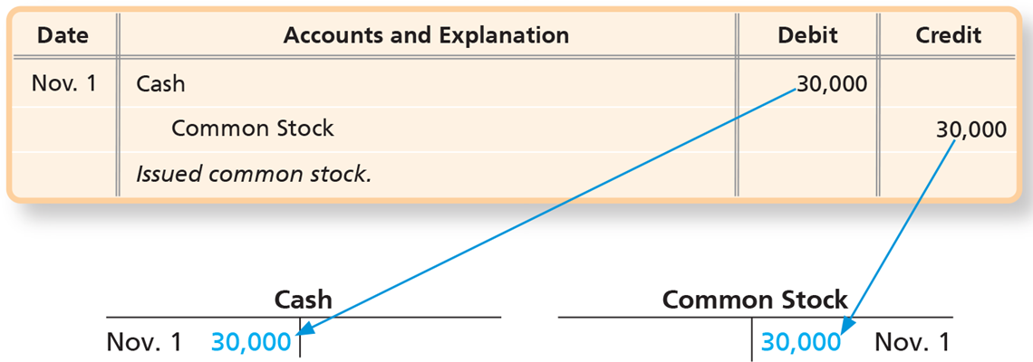
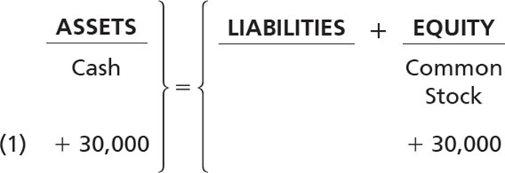
Journalizing and Posting Transactions (5 of 24)
Transaction 1—Stockholder Contribution
Notes:
Step 4: The journal entry is posted to the ledger. The dollar amounts are transferred from the journal to the ledger with a debit or credit identical to the debit and credit used in the journal. This step is automated when computerized systems are used to record the business transactions.
Step 5: Determine if the accounting equation is in balance. Note that the accounting equation balances in this example.
The debit amount of 30,000 is posted as November 1; 30,000 in the debit column of the Cash T-account, and the credit amount of 30,000 is posted in the credit column of the Common Stock T-account as 30,000, November 1.

Slide 28
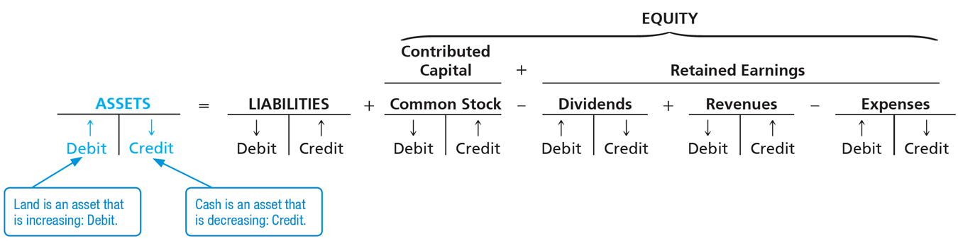
Journalizing and Posting Transactions (6 of 24)
Transaction 2—Purchase of Land for Cash
On November 2, Smart Touch Learning paid $20,000 cash for land.
Notes:
In Transaction 2, Smart Touch Learning paid $20,000 cash for land.
Step 1: The two accounts involved are Cash (Asset) and Land (Asset).
Step 2: Cash decreases with a credit, and Land increases with a debit.
Assets (highlighted) = liabilities (highlighted) + equity (highlighted).
Assets: Debit = highlighted, land is an asset that is increasing. Credit = highlighted, cash is an asset that is decreasing..
Liabilities: Debit = decrease, credit = increase.
Equity = Bright, Capital has debit = decrease, credit = increase minus Bright, Withdrawals: debit = increase, credit = decrease + Revenues: debit = decrease, credit = increase. Expenses: debit = increase, credit = decrease.

Slide 29
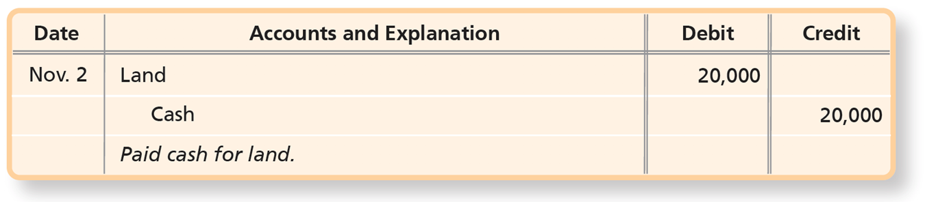
Journalizing and Posting Transactions (7 of 24)
Transaction 2—Purchase of Land for Cash
Notes:
Step 3: The transaction is recorded in the journal.
Step 4: The journal entry is posted to the ledger.
A table has 3 rows and 4 columns. The columns have the following headings from left to right. Date, Accounts and Explanation, Debit, Credit. The row entries are as follows. Row 1. Date, November 2. Accounts and Explanation, Land. Debit, 20000. Credit, blank. Row 2. Date, blank. Accounts and Explanation, Cash. Debit, blank. Credit, 20000. Row 3. Date, Blank. Accounts and Explanation, Paid cash for land.. Debit, blank. Credit, blank.

Slide 30
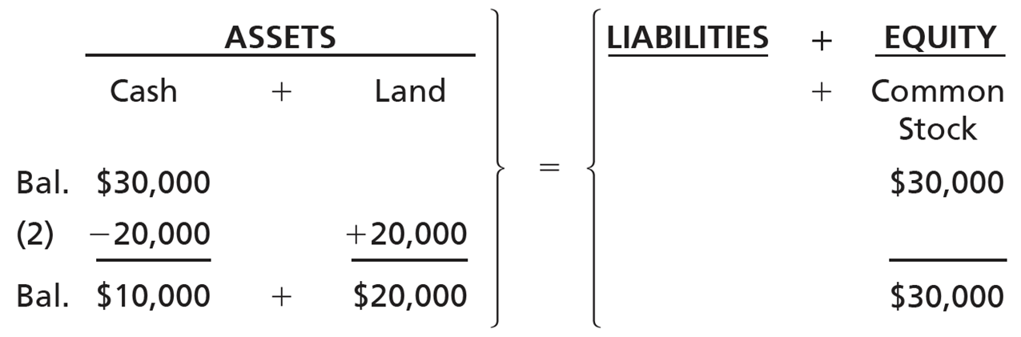
Journalizing and Posting Transactions (8 of 24)
Transaction 2—Purchase of Land for Cash
Notes:
Step 5: The accounting equation is still in balance because Land was increased with a debit and Cash was deceased with a credit of the same amount.
Assets = liabilities + equity
• Assets = cash + land
• Liabilities = blank
• Equity = common stock
• Starting balance: Assets = $30,000 cash, Liabilities = blank, Equity = $30,000 common stock.
• Transaction 2: 20,000 cash subtracted from assets and 20,000 land added to assets.
• Ending balance: Assets = $10,000 cash + $20,000 land, Liabilities = blank, Equity = $30,000 common stock.

Slide 31
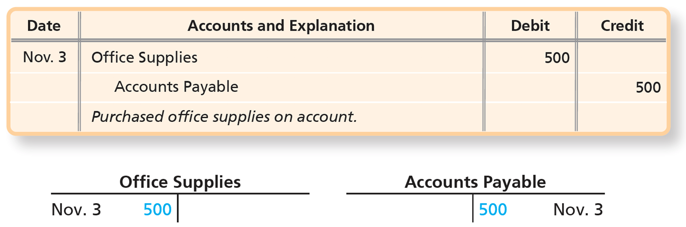
Journalizing and Posting Transactions (9 of 24)
Transaction 3—Purchase of Office Supplies on Account
Smart Touch Learning buys $500 of office supplies on account on November 3.
Notes:
In Transaction 3, Smart Touch Learning buys $500 of office supplies on account. The supplies will benefit the company in future periods so they are an asset until they are used. The two accounts involved are Office Supplies (Asset) and Accounts Payable (Liability). Office Supplies increases with a debit, and Accounts Payable increases with a credit.
A table has 3 rows and 4 columns. The columns have the following headings from left to right. Date, Accounts and Explanation, Debit, Credit. The row entries are as follows. Row 1. Date, November 3. Accounts and Explanation, Office Supplies. Debit, 500. Credit, Blank. Row 2. Date, Blank. Accounts and Explanation, Accounts Payable. Debit, blank. Credit, 500. Row 3. Date, Blank. Accounts and Explanation, Purchased office supplies on account.. Debit, blank. Credit, Blank.
A ledger posting for the purchase of office supplies (transaction 3).
The ledger records transaction 3 as T accounts as follows: November 3 500 in the debit column of the Office Supplies account and 500 November 3 in the credit column of the Accounts Payable account.

Slide 32
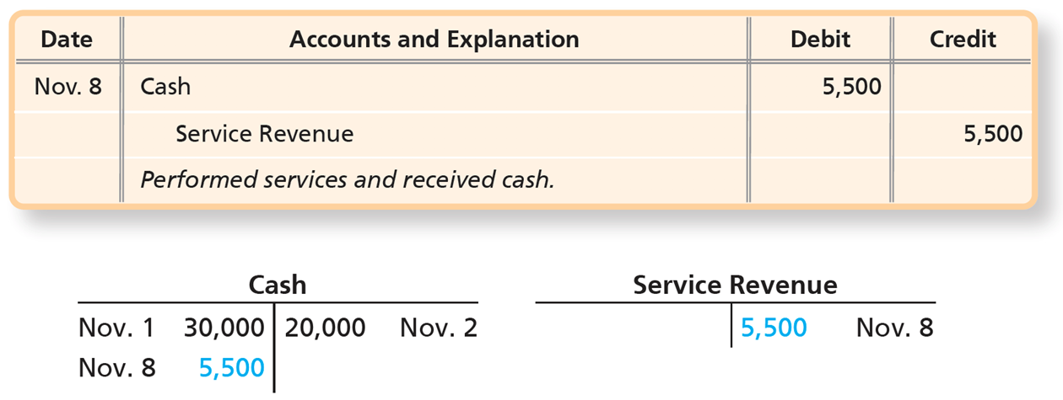
Journalizing and Posting Transactions (10 of 24)
Transaction 4—Earning of Service Revenue for Cash
On November 8, Smart Touch Learning collected cash of $5,500 for service revenue that the business earned by providing e-learning services for clients.
Notes:
In Transaction 4, the company collects $5,500 cash for revenue earned by providing services. The two accounts involved are Cash (Asset) and Service Revenue (Equity). Cash increases with a debit, and Service Revenue increases with a credit.
A table has 3 rows and 4 columns. The columns have the following headings from left to right. Date, Accounts and Explanation, Debit, Credit. The row entries are as follows. Row 1. Date, November 8. Accounts and Explanation, Cash. Debit, 5500. Credit, Blank. Row 2. Date, Blank. Accounts and Explanation, Service Revenue. Debit, blank. Credit, 5500. Row 3. Date, Blank. Accounts and Explanation, Performed services and received cash.. Debit, blank. Credit, Blank.
Two T accounts labeled, cash and service revenue.
T accounts as follows:
Cash
• Debit = November 1 30,000; November 8 5,500
• Credit = 20,000 November 2
Service Revenue
• Debit = blank
• Credit = 5,500 November 8

Slide 33
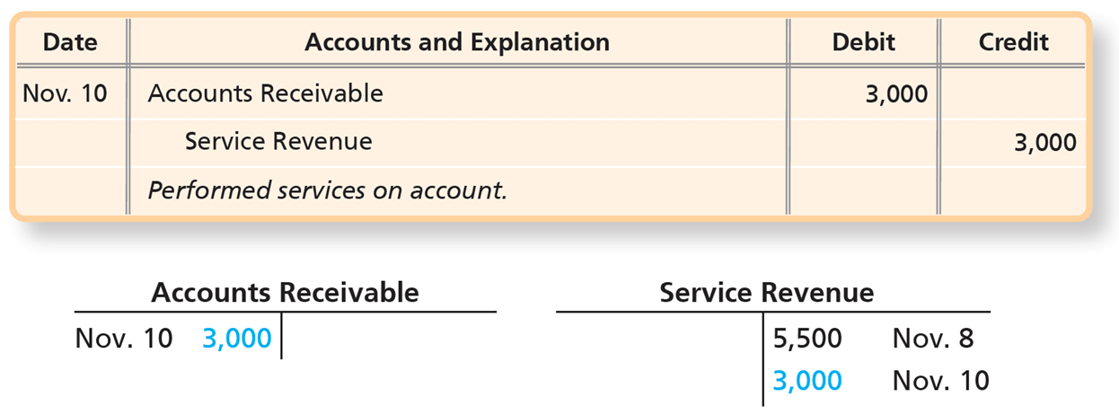
Journalizing and Posting Transactions (11 of 24)
Transaction 5—Earning of Service Revenue on Account
On November 10, Smart Touch Learning performed services for clients, for which the clients will pay the company later. The business earned $3,000 of service revenue on account.
Notes:
In Transaction 5, the company earns $3,000 revenue on account by providing services. The two accounts involved are Accounts Receivable (Asset) and Service Revenue (Equity). Accounts Receivable increases with a debit, and Service Revenue increases with a credit.
A table has 3 rows and 4 columns. The columns have the following headings from left to right. Date, Accounts and Explanation, Debit, Credit. The row entries are as follows. Row 1. Date, November 10. Accounts and Explanation, Accounts Receivable. Debit, 3000. Credit, blank. Row 2. Date, Blank. Accounts and Explanation, Service Revenue. Debit, blank. Credit, 3000. Row 3. Date, Blank. Accounts and Explanation, Performed services on account.. Debit, blank. Credit, blank.
Two T accounts labeled, accounts receivable and service revenue.
T accounts as follows:
Accounts Receivable
• Debit = November 10 3,000
• Credit = blank
Service Revenue
• Debit = blank
• Credit = 5,500 November 8; 3,000 November 10

Slide 34
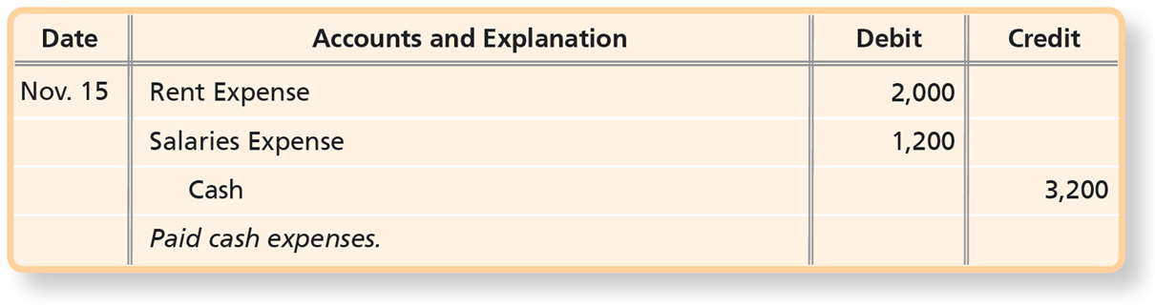
Journalizing and Posting Transactions (12 of 24)
Transaction 6—Payment of Expenses with Cash
Smart Touch Learning paid the following cash expenses on November 15: office rent, $2,000, and employee salaries, $1,200.
Note: A compound journal entry is a journal entry with multiple debits and/or credits.
Notes:
In Transaction 6, the company paid the following cash expenses on November 15: office rent, $2,000, and employee salaries, $1,200. The three accounts involved are Cash (Asset), Rent Expense (Equity) and Salaries Expense (Equity). Cash decreases with a credit and the two expense accounts increase with a debit.
A compound journal entry has more than two accounts, but the total dollar value of the debits must equal the total dollar value of the credits.
A table has 4 rows and 4 columns. The columns have the following headings from left to right. Date, Accounts and Explanation, Debit, Credit. The row entries are as follows. Row 1. Date, November 15. Accounts and Explanation, Rent Expense. Debit, 2000. Credit, blank. Row 2. Date, Blank. Accounts and Explanation, Salaries Expense. Debit, 1200. Credit, blank. Row 3. Date, Blank. Accounts and Explanation, Cash. Debit, blank. Credit, 3200. Row 4. Date, Blank. Accounts and Explanation, Paid cash expenses.. Debit, blank. Credit, blank.

Slide 35
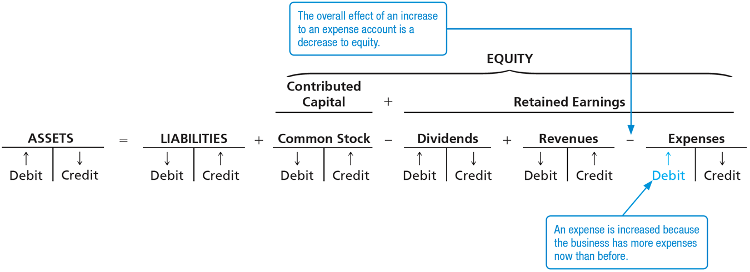
Journalizing and Posting Transactions (13 of 24)
Transaction 6—Payment of Expenses with Cash
Notes:
In Transaction 6, the debits to the expense accounts increase the expenses and, in turn, decrease equity.
Credit, 20,000, November 2. Line 2, debit, November 8, 5,500. Credit, 3,200, November 15. T-account: rent expense. Line 1, debit, November 15, 2,000. Credit, blank. T-account: salaries expense. Line 1, debit, November 15, 1,200. Credit, blank.
The overall effect of an increase to an expense account is a decrease to equity, indicated by expenses being subtracted from retained earnings. The expense is increased because the business has more expenses than before, indicated by increased debit in the expenses account.

Slide 36
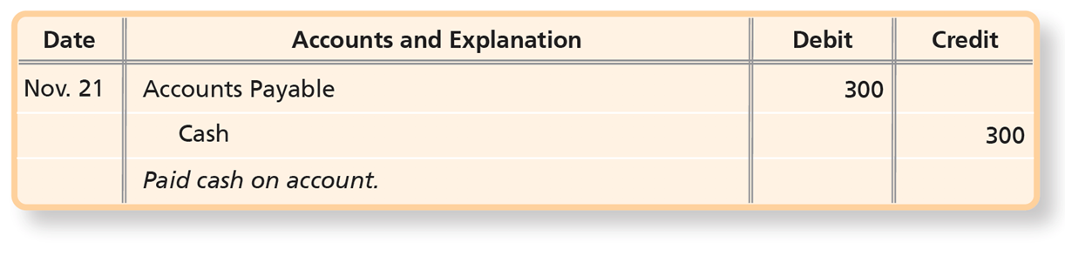

Journalizing and Posting Transactions (14 of 24)
Transaction 7—Payment on Account (Accounts Payable)
On November 21, Smart Touch Learning paid $300 on the accounts payable created in Transaction 3.
Notes:
In Transaction 7, the company paid $300 on the accounts payable created in Transaction 3. The two accounts involved are Cash (Asset) and Accounts Payable (Liability). Cash decreases with a credit and Accounts payable decreases with a debit.
A table has 3 rows and 4 columns. The columns have the following headings from left to right. Date, Accounts and Explanation, Debit, Credit. The row entries are as follows. Row 1. Date, November 21. Accounts and Explanation, Accounts Payable. Debit, 300. Credit, blank. Row 2. Date, Blank. Accounts and Explanation, Cash. Debit, blank. Credit, 300. Row 3. Date, Blank. Accounts and Explanation, Paid cash on account. Debit, blank. Credit, blank.
T accounts as follows:
Cash
• Debit = November 1 30,000; November 8 5,500
• Credit = 20,000 November 2; 3,200 November 15; 300 November 21
Accounts Payable
• Debit = November 21 300
• Credit = 500 November 3

Slide 37
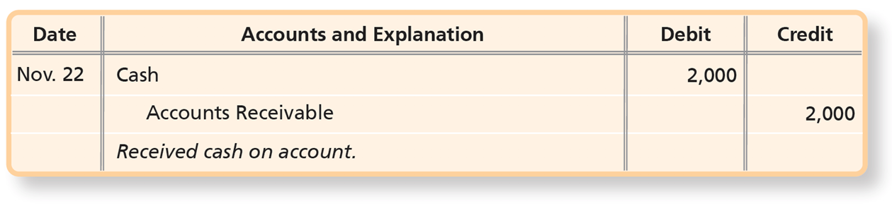
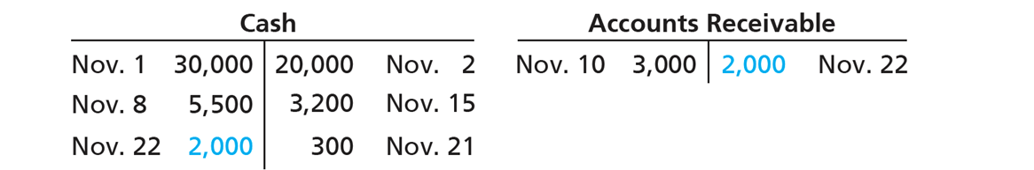
Journalizing and Posting Transactions (15 of 24)
Transaction 8—Collection on Account (Accounts Receivable)
On November 22, Smart Touch Learning collected $2,000 cash from a client in Transaction 5.
Notes:
In Transaction 8, the company collected $2,000 cash from a client in Transaction 5. The two accounts involved are Cash (Asset) and Accounts Receivable (Asset). Cash increases with a debit and Accounts receivable decreases with a credit.
A table has 3 rows and 4 columns. The columns have the following headings from left to right. Date, Accounts and Explanation, Debit, Credit. The row entries are as follows. Row 1. Date, November 22. Accounts and Explanation, Cash. Debit, 2000. Credit, blank. Row 2. Date, Blank. Accounts and Explanation, Accounts Receivable. Debit, blank. Credit, 2000. Row 3. Date, Blank. Accounts and Explanation, Received cash on account.. Debit, blank. Credit, blank.
T accounts as follows:
Cash
• Debit = November 1 30,000; November 8 5,500; November 22 2,000
• Credit = 20,000 November 2; 3,200 November 15; 300 November 21
Accounts Receivable
• Debit = November 10 3,000
• Credit = 2,000 November 22

Slide 38
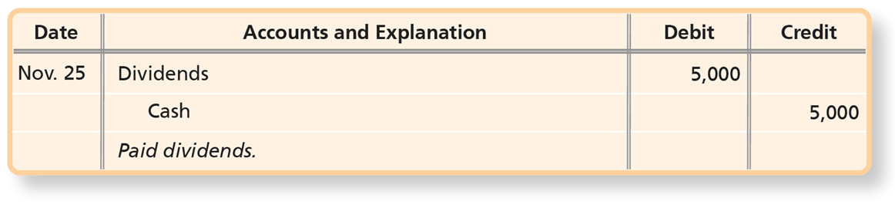
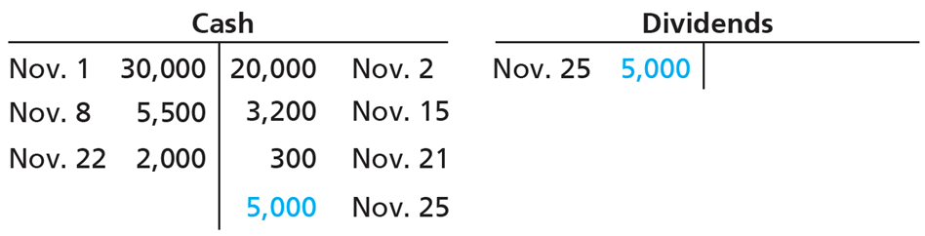
Journalizing and Posting Transactions (16 of 24)
Transaction 9—Payment of Cash Dividend
On November 25, a payment of $5,000 cash was paid for dividends.
Notes:
In Transaction 9, the company pays $5,000 cash for dividends. The two accounts involved are Cash (Asset) and Dividends (Equity). Cash decreases with a credit and Dividends increases with a debit. The debit to Dividends decreases equity.
A table has 3 rows and 4 columns. The columns have the following headings from left to right. Date, Accounts and Explanation, Debit, Credit. The row entries are as follows. Row 1. Date, November 25. Accounts and Explanation, Bright, Withdrawals. Debit, 5000. Credit, blank. Row 2. Date, Blank. Accounts and Explanation, Cash. Debit, blank. Credit, 5000. Row 3. Date, Blank. Accounts and Explanation, Owner withdrawal.. Debit, blank. Credit, blank.
T accounts as follows:
Cash
• Debit = November 1 30,000; November 8 5,500; November 22 2,000
• Credit = 20,000 November 2; 3,200 November 15; 300 November 21; 5,000 November 25
Dividends
• Debit = November 25 5,000
• Credit = blank

Slide 39
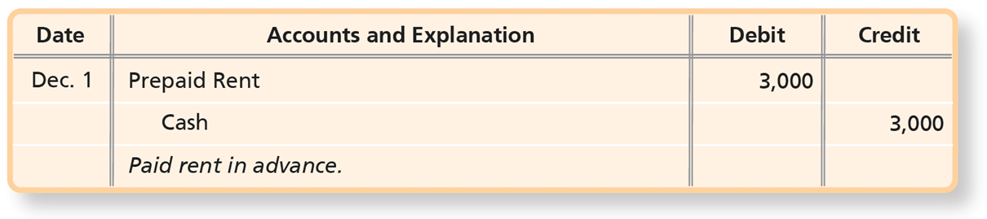
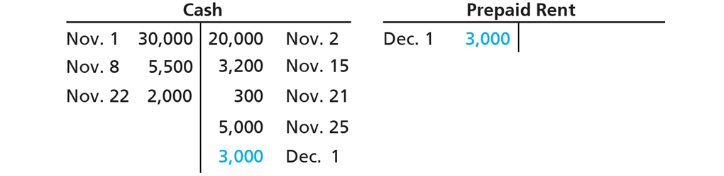
Journalizing and Posting Transactions (17 of 24)
Transaction 10—Prepaid Expenses
On December 1, Smart Touch Learning prepays three months’ office rent of $3,000.
Notes:
In Transaction 10, the company prepays three months’ office rent of $3,000. The two accounts involved are Cash (Asset) and Prepaid Rent (Asset). Prepaid Rent is an asset because the company will receive a benefit in the future. Cash decreases with a credit and Prepaid Rent increases with a debit.
A table has 3 rows and 4 columns. The columns have the following headings from left to right. Date, Accounts and Explanation, Debit, Credit. The row entries are as follows. Row 1. Date, December 1. Accounts and Explanation, Prepaid Rent. Debit, 3000. Credit, blank. Row 2. Date, Blank. Accounts and Explanation, Cash. Debit, blank. Credit, 3000. Row 3. Date, Blank. Accounts and Explanation, Paid rent in advance.. Debit, blank. Credit, blank.
T accounts as follows:
Cash
• Debit = November 1 30,000; November 8 5,500; November 22 2,000
• Credit = 20,000 November 2; 3,200 November 15; 300 November 21; 5,000 November 25; 3,000 December 1
Prepaid Rent
• Debit = December 1 3,000
• Credit = blank

Slide 40
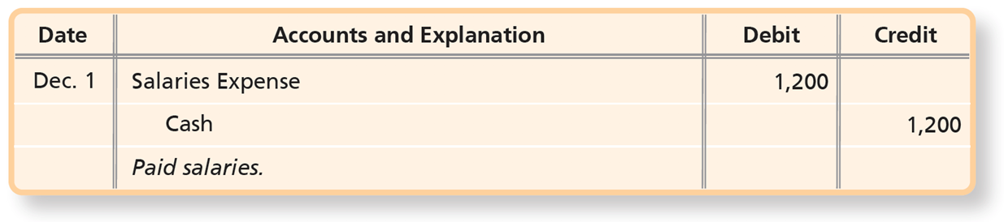
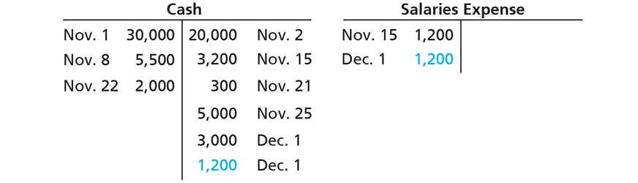
Journalizing and Posting Transactions (18 of 24)
Transaction 11—Payment of Expense with Cash
On December 1, Smart Touch Learning paid employee salaries of $1,200.
Notes:
In Transaction 11, the company pays employee salaries of $1,200. The two accounts involved are Cash (Asset) and Salaries Expense (Equity). Cash decreases with a credit and Salaries Expense increases with a debit. The debit to the expense account, in turn, decreases equity.
A table has 3 rows and 4 columns. The columns have the following headings from left to right. Date, Accounts and Explanation, Debit, Credit. The row entries are as follows. Row 1. Date, December 1. Accounts and Explanation, Salaries Expense. Debit, 1200. Credit, blank. Row 2. Date, Blank. Accounts and Explanation, Cash. Debit, blank. Credit, 1200. Row 3. Date, Blank. Accounts and Explanation, Paid salaries.. Debit, blank. Credit, blank.
T accounts as follows:
Cash
• Debit = November 1 30,000; November 8 5,500; November 22 2,000
• Credit = 20,000 November 2; 3,200 November 15; 300 November 21; 5,000 November 25; 3,000 December 1; 1,200 December 1
Salaries Expense
• Debit = November 15 1,200; December 1 1,200
• Credit = blank

Slide 41
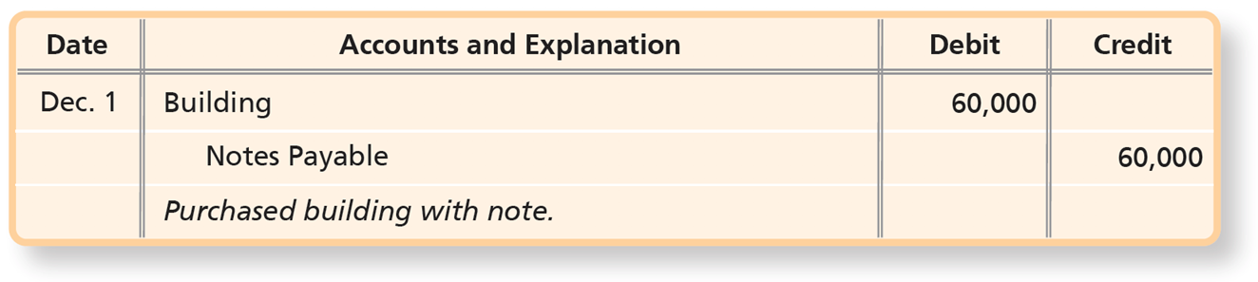
Journalizing and Posting Transactions (19 of 24)
Transaction 12—Purchase of Building with Notes Payable
On December 1, Smart Touch Learning purchased a $60,000 building in exchange for a note payable.
Notes:
In Transaction 12, the company purchased a $60,000 building in exchange for a note payable. The two accounts involved are Building (Asset) and Notes Payable (Liability). Building increases with a debit, and Notes Payable increases with a credit.
A table has 3 rows and 4 columns. The columns have the following headings from left to right. Date, Accounts and Explanation, Debit, Credit. The row entries are as follows. Row 1. Date, December 1. Accounts and Explanation, Building. Debit, 60000. Credit, blank. Row 2. Date, Blank. Accounts and Explanation, Notes payable.. Debit, blank. Credit, 60000. Row 3. Date, Blank. Accounts and Explanation, Purchase of building with note.. Debit, blank. Credit, blank.

Slide 42
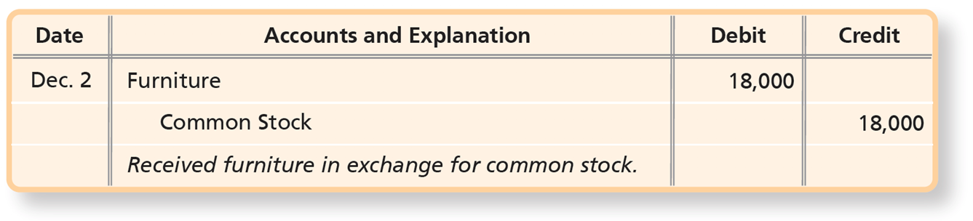
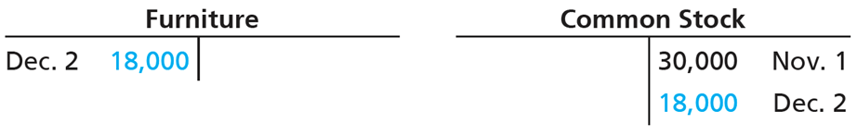
Journalizing and Posting Transactions (20 of 24)
Transaction 13—Stockholder Contribution
On December 2, Smart Touch Learning received a contribution of furniture with a fair market value of $18,000 from Sheena Bright. In exchange, Smart Touch Learning issued common stock.
Notes:
In Transaction 13, the company received a contribution of furniture with a fair market value of $18,000 in exchange for common stock. The two accounts involved are Furniture (Asset) and Common Stock (Equity). Furniture increases with a debit, and Common Stock increases with a credit.
A table has 3 rows and 4 columns. The columns have the following headings from left to right. Date, Accounts and Explanation, Debit, Credit. The row entries are as follows. Row 1. Date, December 2. Accounts and Explanation, Furniture. Debit, 18000. Credit, blank. Row 2. Date, Blank. Accounts and Explanation, Bright, Capital. Debit, blank. Credit, 18000. Row 3. Date, Blank. Accounts and Explanation, Owner contribution of furniture.. Debit, blank. Credit, blank.

Slide 43
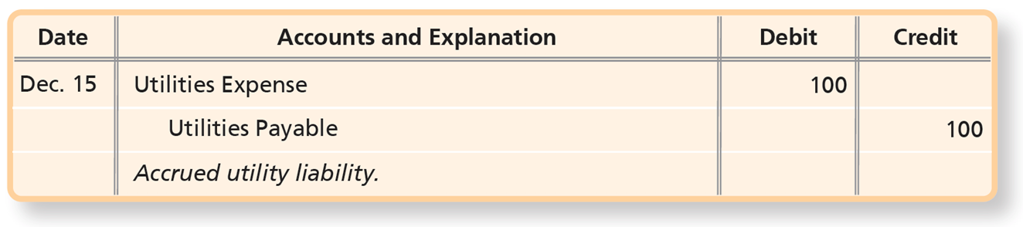
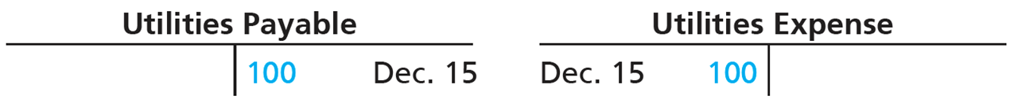
Journalizing and Posting Transactions (21 of 24)
Transaction 14—Accrued Liability
On December 15, Smart Touch Learning received a telephone bill for $100 and will pay this expense next month.
Notes:
In Transaction 14, the company received a telephone bill for $100 and will pay this expense next month. This results in an accrued liability. The two accounts involved are Utilities Payable (Liability) and Utilities Expense (Equity). Utilities Payable increases with a credit, and Utilities Expense increases with a debit.
A table has 3 rows and 4 columns. The columns have the following headings from left to right. Date, Accounts and Explanation, Debit, Credit. The row entries are as follows. Row 1. Date, December 15. Accounts and Explanation, Utilities Expense. Debit, 100. Credit, blank. Row 2. Date, Blank. Accounts and Explanation, Utilities Payable. Debit, blank. Credit, 100. Row 3. Date, Blank. Accounts and Explanation, Accrued utility liability.. Debit, blank. Credit, blank.

Slide 44
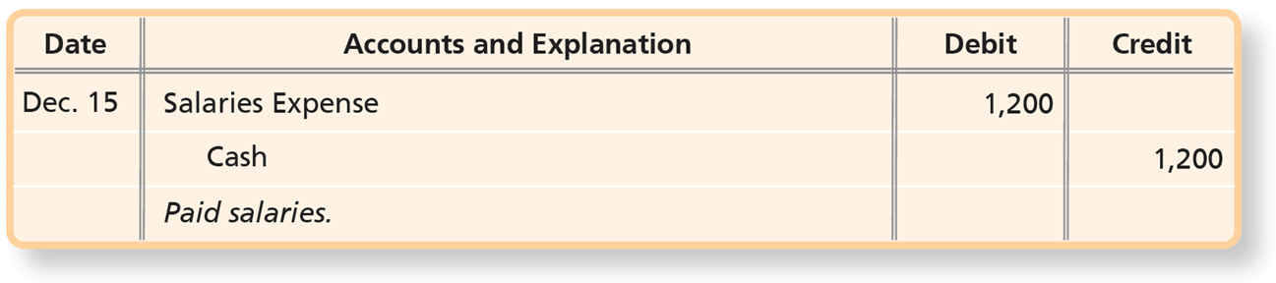
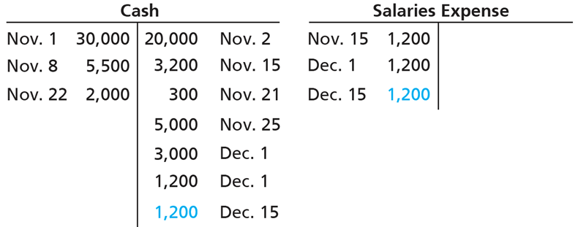
Journalizing and Posting Transactions (22 of 24)
Transaction 15—Payment of Expense with Cash
On December 15, Smart Touch Learning paid employee salaries of $1,200.
Notes:
In Transaction 15, the company paid employee salaries of $1,200. The two accounts involved are Cash (Asset) and Salaries Expense (Equity). Cash decreases with a credit, and Salaries Expense increases with a debit.
A table has 3 rows and 4 columns. The columns have the following headings from left to right. Date, Accounts and Explanation, Debit, Credit. The row entries are as follows. Row 1. Date, December 15. Accounts and Explanation, Salaries Expense. Debit, 1200. Credit, blank. Row 2. Date, Blank. Accounts and Explanation, Cash. Debit, blank. Credit, 1200. Row 3. Date, Blank. Accounts and Explanation, Paid salaries.. Debit, blank. Credit, blank.
T accounts as follows:
Cash
• Debit = November 1 30,000; November 8 5,500; November 22 2,000
• Credit = 20,000 November 2; 3,200 November 15; 300 November 21; 5,000 November 25; 3,000 December 1; 1,200 December 1; 1,200 December 15
Salaries Expense
• Debit = November 15 1,200; December 1 1,200; December 15 1,200
• Credit = 0

Slide 45
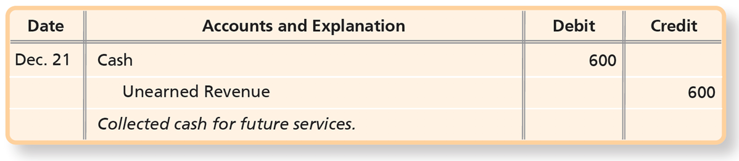
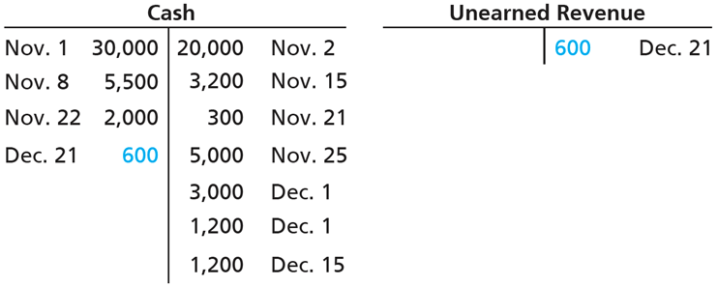
Journalizing and Posting Transactions (23 of 24)
Transaction 16—Unearned Revenue
On December 21, a law firm engages Smart Touch Learning to provide e-learning services and agrees to pay $600 in advance.
Notes:
In Transaction 16, the company receives $600 cash prior to providing services. The two accounts involved are Cash (Asset) and Unearned Revenue (Liability). Cash increases with a debit, and Unearned Revenues increases with a credit.
A table has 3 rows and 4 columns. The columns have the following headings from left to right. Date, Accounts and Explanation, Debit, Credit. The row entries are as follows. Row 1. Date, December 21. Accounts and Explanation, Cash. Debit, 600. Credit, blank. Row 2. Date, Blank. Accounts and Explanation, Unearned Revenue. Debit, blank. Credit, 600. Row 3. Date, Blank. Accounts and Explanation, Collected cash for future services.. Debit, blank. Credit, blank.
T accounts as follows:
Cash
• Debit = November 1 30,000; November 8 5,500; November 22 2,000; December 21 600
• Credit = 20,000 November 2; 3,200 November 15; 300 November 21; 5,000 November 25; 3,000 December 1; 1,200 December 1; 1,200 December 15
Unearned Revenue
• Debit = blank
• Credit = 600 December 21

Slide 46
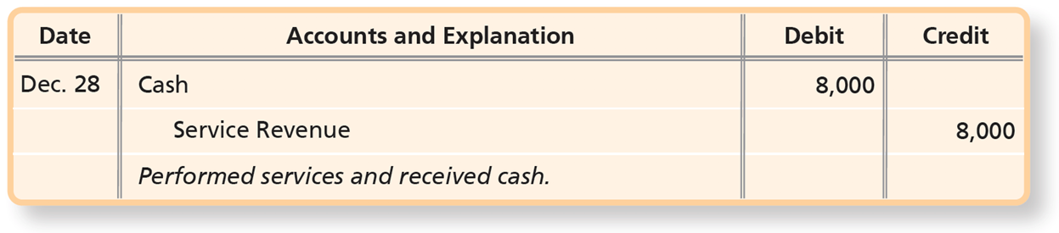
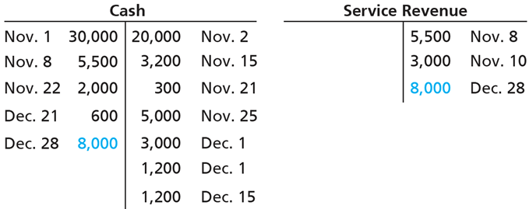
Journalizing and Posting Transactions (24 of 24)
Transaction 17—Earning of Service Revenue for Cash
On December 28, Smart Touch Learning collected cash of $8,000 for Service Revenue that the business earned by providing e-learning services for clients.
Notes:
In Transaction 17, the company receives $8,000 cash prior for providing services. The two accounts involved are Cash (Asset) and Service Revenue (Equity). Cash increases with a debit, and Service Revenue increases with a credit.
A table has 3 rows and 4 columns. The columns have the following headings from left to right. Date, Accounts and Explanation, Debit, Credit. The row entries are as follows. Row 1. Date, December 28. Accounts and Explanation, Cash. Debit, 8000. Credit, blank. Row 2. Date, Blank. Accounts and Explanation, Service Revenue. Debit, blank. Credit, 8000. Row 3. Date, Blank. Accounts and Explanation, Performed services and received cash.. Debit, blank. Credit, blank.
T accounts as follows:
Cash
• Debit = November 1 30,000; November 8 5,500; November 22 2,000; December 21 600; December 28 8,000
• Credit = 20,000 November 2; 3,200 November 15; 300 November 21; 5,000 November 25; 3,000 December 1; 1,200 December 1; 1,200 December 15
Service Revenue
• Debit = blank
• Credit = 5,500 November 8; 3,000 November 10; 8,000 December 28

Slide 47
The Ledger Accounts After Posting (1 of 2)
Exhibit F:2-7 (on the following slide) shows Smart Touch Learning’s accounts after posting journal entries in November and December.
Notice the total assets of $114,700 equals the total liabilities of $60,900 plus equity of $53,800.
Notes:
After recording the journal entries, the amounts are posted to the ledger. Exhibit F:2-7 is a summary of the ledger accounts. The accounting equation is in balance as assets equal $114,700, and liabilities plus equity also equals $114,700.

Slide 48
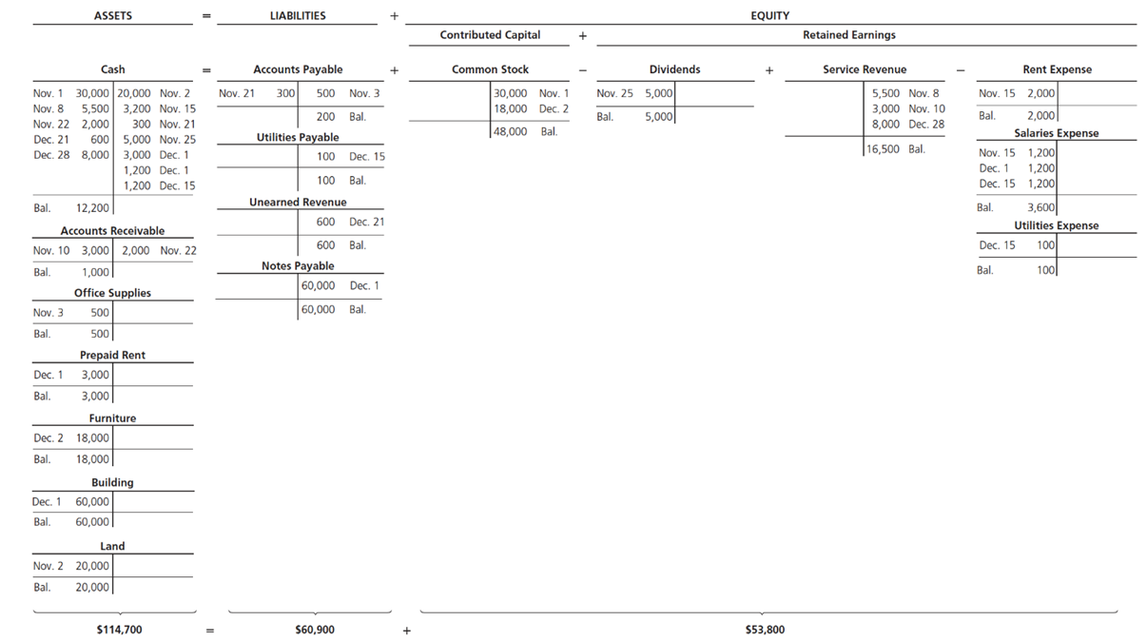
The Ledger Accounts After Posting (2 of 2)
Exhibit F:2-7 Smart Touch Learning’s Accounts After Posting Journal Entries in November and December
Notes:
Exhibit F:2-7. Notice the liabilities and equity values of $60,900 and $53,800 equal total assets of $114,700.
The T-Accounts are as follows. Assets: Cash, accounts receivable, office supplies, prepaid rent, furniture, building, and land. Cash: debit = November 1, 30,000; November 8, 5,500; November 22, 2,000; December 21, 600; December 28, 8,000. Credit = 20,000 November 2; 3,200, November 15; 300, November 21; 5,000, November 25; 3,000, December 1; 1,200, December 1; 1,200, December 15. Ending debit balance = 12,200. Accounts receivable: Debit = November 10, 3,000. Credit = 2,000, November 22. Ending debit balance = 1,000. Office Supplies: Debit = November 3, 500. Ending debit balance = 500. Prepaid Rent: Debit = December 1, 3,000. Ending debit balance = 3,000. Furniture: Debit = December 2, 18,000. Ending debit balance = 18,000. Building: Debit = December 1, 60,000. The ending debit balance = 60,000. Land: Debit = November 2, 20,000. The ending debit balance = 20,000. Total Ending balance = $114,700. Liabilities + Equity. Liabilities: accounts payable, utilities payable, unearned revenue, and notes payable. Accounts payable: Debit = November 21, 300. Credit = 500, November 3. Ending credit balance = 200. Utilities Payable: Credit = 100, December 15. Ending credit balance = 100. Unearned revenue: Credit = 600, December 21. Ending credit balance = 600. Notes payable: Credit = 60,000, December 1. Ending credit balance = 60,000. Total liabilities balance = $60,900. Equity: common stock minus dividends + service revenue minus rent expense, salaries expense and utilities expense. Common stock: Credit = 30,000, November 1; 18,000, December 2. Ending credit balance = 48,000. Dividends: Debit = November 25, 5,000. Ending debit balance = 5,000. Service revenue: Credit = 5,500, November 8; 3,000, November 10; 8,000, December 28. Ending credit balance = 16,500. Rent expense: Debit= November 15, 2,000. Ending debit balance = 2,000. Salaries expense: Debit = November 15, 1,200; December 1, 1,200; December 15, 1,200. Ending debit balance = 3,600. Utilities expense: Debit = December 15, 100. Ending debit balance = 100. Total equity balance = $53,800.

Slide 49
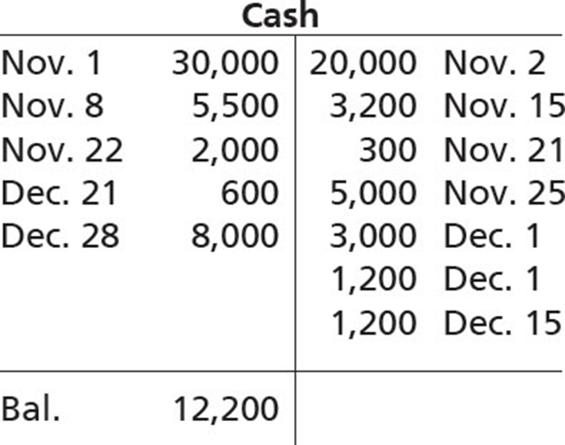
The Four-Column Account: An Alternative to the T-Account
Exhibit F:2-8 T-Account Versus Four-Column Account
Notes:
This slide illustrates the T-account. The next slide shows an alternative, the four-column account.
T-account: Cash. Debit = November 1, 30,000; November 8, 5,500; November 22, 2,000; December 21, 600; December 28, 8,000. Credit = 20,000, November 2; 3,200 November 15; 300 November 21; 5,000, November 25; 3,000, December 1; 1,200, December 1; 1,200, December 15. Ending Debit Balance = 12,200.

Slide 50
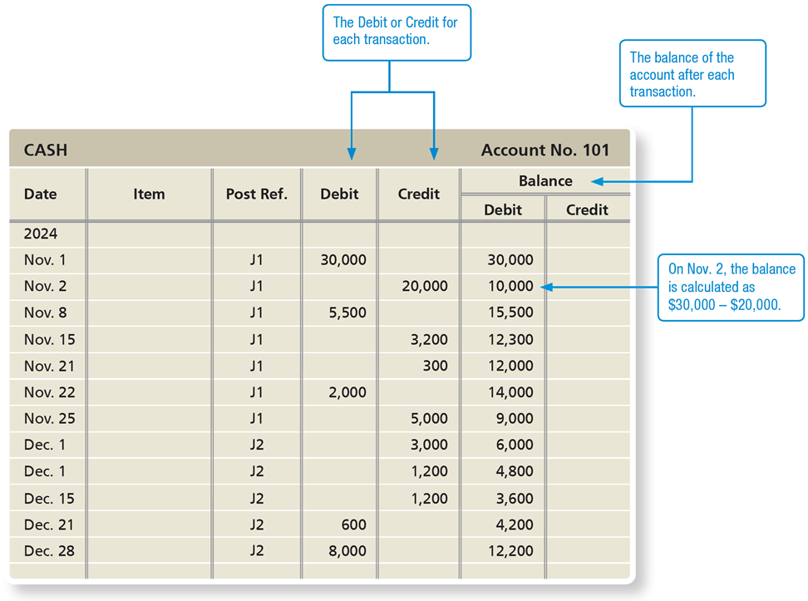
Exhibit F:2-8 T-Account Versus Four-Column Account
Notes:
The four-column account is an alternative to the T-account. The four-column account has debit and credit columns as well as a running balance of the account. Similar to the T-account, the four-column account lists the date of the journal entry, a posting reference, and the debit or credit amount.
The Debit and Credit columns contain the debit and credit for each transaction, and the Balance-Debit and Balance-Credit columns contain the balance of the account after each transaction.
CASH Account No. 101:
A table has 13 rows and 7 columns. The columns have the following headings from left to right. Date, Item, Post Ref., Debit, Credit, Balance - Debit, Balance - Credit, . The row entries are as follows. Row 1. Date, 2024. Item, Blank. Post Ref., Blank. Debit, blank. Credit, blank. Balance - Debit, blank. Balance - Credit, Blank. Row 2. Date, November 1. Item, blank. Post Ref., J1. Debit, 30000. Credit, blank. Balance - Debit, 30000. Balance - Credit, Blank. Row 3. Date, November 2. Item, blank. Post Ref., J1. Debit, blank. Credit, 20000. Balance - Debit, 10000. Balance - Credit, Blank. Row 4. Date, November 8. Item, blank. Post Ref., J1. Debit, 5500. Credit, blank. Balance - Debit, 15500. Balance - Credit, Blank. Row 5. Date, November 15. Item, blank. Post Ref., J1. Debit, blank. Credit, 3200. Balance - Debit, 12300. Balance - Credit, Blank. Row 6. Date, November 21. Item, blank. Post Ref., J1. Debit, blank. Credit, 300. Balance - Debit, 12000. Balance - Credit, Blank. Row 7. Date, November 22. Item, blank. Post Ref., J1. Debit, 2000. Credit, blank. Balance - Debit, 14000. Balance - Credit, Blank. Row 8. Date, November 25. Item, blank. Post Ref., J1. Debit, blank. Credit, 5000. Balance - Debit, 9000. Balance - Credit, Blank. Row 9. Date, December 1. Item, blank. Post Ref., J2. Debit, blank. Credit, 3000. Balance - Debit, 6000. Balance - Credit, Blank. Row 10. Date, December 1. Item, blank. Post Ref., J2. Debit, blank. Credit, 1200. Balance - Debit, 4800. Balance - Credit, Blank. Row 11. Date, December 15. Item, blank. Post Ref., J2. Debit, blank. Credit, 1200. Balance - Debit, 3600. Balance - Credit, Blank. Row 12. Date, December 21. Item, blank. Post Ref., J2. Debit, 600. Credit, blank. Balance - Debit, 4200. Balance - Credit, Blank. Row 13. Date, December 28. Item, blank. Post Ref., J2. Debit, 8000. Credit, blank. Balance - Debit, 12200. Balance - Credit, Blank.

Slide 51
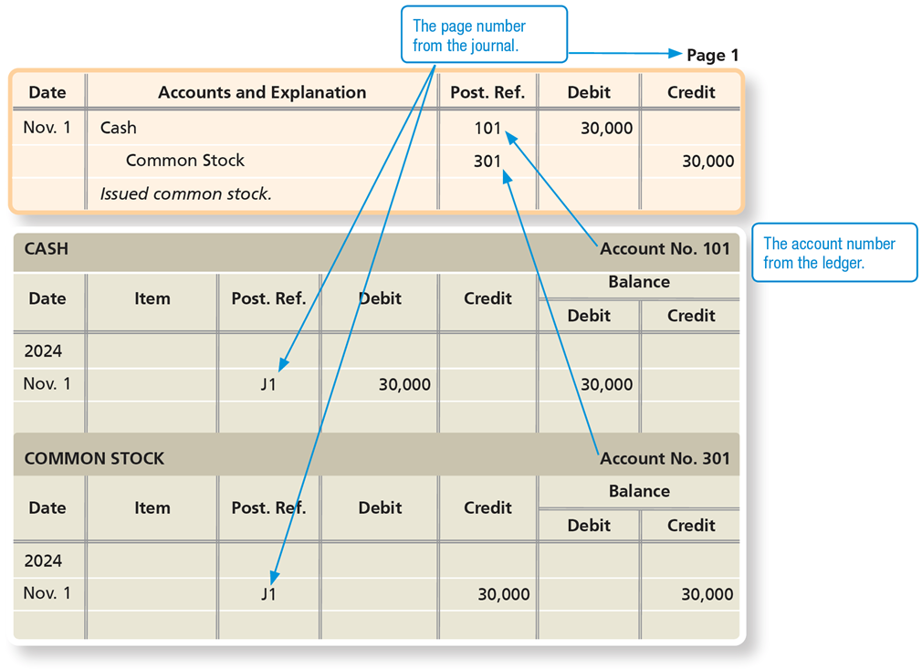
Exhibit F:2-9 Posting References
Notes:
Exhibit F:2-9 shows the posting and associated posting references for Transaction 1 of Smart Touch Learning. This process is automated in a computerized environment.
The journal entry on page 1 is as follows:
A table has 3 rows and 5 columns. The columns have the following headings from left to right. Date, Accounts and Explanation, Post Ref., Debit, Credit, . The row entries are as follows. Row 1. Date, 37196. Accounts and Explanation, Cash. Post Ref., 101. Debit, 30000. Credit, blank. Row 2. Date, blank. Accounts and Explanation, Bright, Capital. Post Ref., 301. Debit, blank. Credit, 30000. Row 3. Date, blank. Accounts and Explanation, Owner contribution.. Post Ref., blank. Debit, blank. Credit, blank.
The page number of the journal entry becomes the post reference number in each account ledger, and the post references in the journal are the account numbers from the ledger.
CASH Account No. 101:
A table has 1 rows and 7 columns. The columns have the following headings from left to right. Date, Item, Post Ref., Debit, Credit, Balance -Debit, Balance -Credit, . The row entries are as follows. Row 1. Date, 2024 November 1. Item, blank. Post Ref., J1. Debit, 30000. Credit, blank. Balance -Debit, 30000. Balance -Credit, blank.
Common stock Account No. 301:
A table has 1 rows and 7 columns. The columns have the following headings from left to right. Date, Item, Post Ref., Debit, Credit, Balance -Debit, Balance - Credit, . The row entries are as follows. Row 1. Date, 2024 November 1. Item, blank. Post Ref., J1. Debit, blank. Credit, 30000. Balance -Debit, blank. Balance - Credit, 30000.

Slide 52
Learning Objective 2.4
Prepare the trial balance and illustrate how to use the trial balance to prepare financial statements

Slide 53
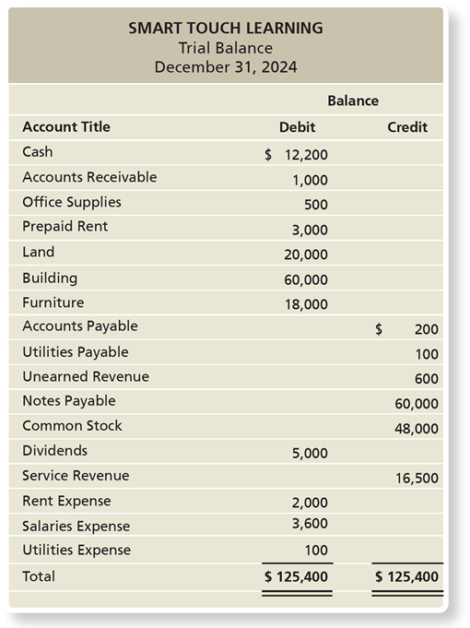
What Is the Trial Balance?
A trial balance is a list of all ledger accounts with their balances at a point in time.
The asset accounts are listed first, followed by liabilities, and then equity.
Exhibit F:2-10 Trial Balance
Notes:
A trial balance is prepared after the journal entries have been posted to the ledger. The trial balance is a summary of all the accounts with their balances. The trial balance lists the assets, liabilities, and equity, in that order. The purpose of the trial balance is to check whether or not the debits equal the credits.
Note: The trial balance and the balance sheet are not the same. The trial balance is an internal document used to verify that debits equal credits. The balance sheet presents the accounting equation and is a financial statement that is used internally and externally.
A trial balance for Smart Touch Learning for December 31, 2024.
A table has 18 rows and 3 columns. The columns have the following headings from left to right. Account Title, Balance Debit, Balance Credit, . The row entries are as follows. Row 1. Account Title, Cash. Balance Debit, $12,200. Balance Credit, blank. Row 2. Account Title, Accounts Receivable. Balance Debit, 1000. Balance Credit, blank. Row 3. Account Title, Office Supplies. Balance Debit, 500. Balance Credit, blank. Row 4. Account Title, Prepaid Rent. Balance Debit, 3000. Balance Credit, blank. Row 5. Account Title, Land. Balance Debit, 20000. Balance Credit, blank. Row 6. Account Title, Building. Balance Debit, 60000. Balance Credit, blank. Row 7. Account Title, Furniture. Balance Debit, 18000. Balance Credit, blank. Row 8. Account Title, Accounts Payable. Balance Debit, Blank. Balance Credit, $200. Row 9. Account Title, Utilities Payable. Balance Debit, Blank. Balance Credit, 100. Row 10. Account Title, Unearned Revenue. Balance Debit, Blank. Balance Credit, 600. Row 11. Account Title, Notes Payable. Balance Debit, Blank. Balance Credit, 60000. Row 12. Account Title, Bright, Capital. Balance Debit, Blank. Balance Credit, 48000. Row 13. Account Title, Bright, Withdrawals. Balance Debit, 5000. Balance Credit, blank. Row 14. Account Title, Service Revenue. Balance Debit, Blank. Balance Credit, 16500. Row 15. Account Title, Rent Expense. Balance Debit, 2000. Balance Credit, blank. Row 16. Account Title, Salaries Expense. Balance Debit, 3600. Balance Credit, blank. Row 17. Account Title, Utilities Expense. Balance Debit, 100. Balance Credit, blank. Row 18. Account Title, Total. Balance Debit, $125,400 . Balance Credit, $125,400 .

Slide 54
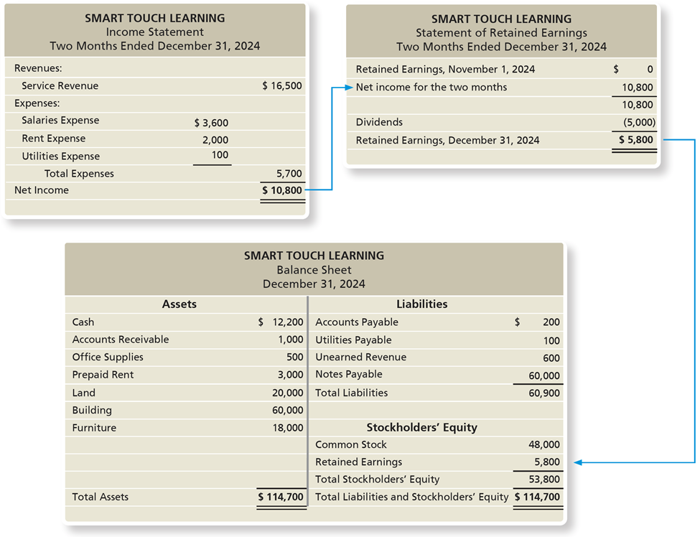
Exhibit F:2-11 Smart Touch Learning’s Financial Statements
Notes:
In addition to verifying the equality of debits and credits, the trial balance is used to prepare the financial statements. The account balances are taken directly from the trial balance to prepare the income statement, statement of retained earnings, and balance sheet.
Net Income on the income statement becomes Net income for two months on the statement of retained earnings. Retained Earnings, December 31, 2024 on the statement of retained earnings becomes Retained Earnings on the balance sheet.
An income statement for Smart Touch Learning for two months ended December 31, 2024
A table has 8 rows and 3 columns. The columns have the following headings from left to right. Accounts, Account Amount, Account Totals, . The row entries are as follows. Row 1. Accounts, Revenues:. Account Amount, Blank. Account Totals, Blank. Row 2. Accounts, Service Revenue. Account Amount, Blank. Account Totals, $16,500. Row 3. Accounts, Expenses:. Account Amount, blank. Account Totals, Blank. Row 4. Accounts, Salaries Expense. Account Amount, $3,600. Account Totals, Blank. Row 5. Accounts, Rent Expense. Account Amount, 2000. Account Totals, Blank. Row 6. Accounts, Utilities Expense. Account Amount, 100. Account Totals, Blank. Row 7. Accounts, Total Expenses. Account Amount, blank. Account Totals, 5700. Row 8. Accounts, Net Income. Account Amount, blank. Account Totals, $10,800 .
A statement of retained earnings of Smart Touch Learning for two months ended December 31, 2024
A table has 5 rows and 2 columns. The columns have the following headings from left to right. Accounts, Dollar amount. The row entries are as follows. Row 1. Accounts, Retained Earnings, November 1, 20 24. Dollar amount, $0. Row 2. Accounts, Net income for the two months. Dollar amount, 10800. Row 3. Accounts, Blank. Dollar amount, 10800. Row 4. Accounts, Dividends. Dollar amount, Negative 5,000 (shown within parenthesis). Row 5. Accounts, Retained Earnings, December 31, 20 24. Dollar amount, $5,800 .
Balance sheet for Smart Touch Learning for December 31, 20 24
A table has 11 rows and 4 columns. The columns have the following headings from left to right. Assets, Dollar amount, Liabilities, Dollar amount. The row entries are as follows. Row 1. Assets, Cash. Dollar amount, $12,200. Liabilities, Accounts Payable. Dollar amount, $200. Row 2. Assets, Accounts Receivable. Dollar amount, 1000. Liabilities, Utilities Payable. Dollar amount, 100. Row 3. Assets, Office Supplies. Dollar amount, 500. Liabilities, Unearned Revenue. Dollar amount, 600. Row 4. Assets, Prepaid Rent. Dollar amount, 3000. Liabilities, Notes Payable. Dollar amount, 60000. Row 5. Assets, Land. Dollar amount, 20000. Liabilities, Total Liabilities. Dollar amount, 60900. Row 6. Assets, Building. Dollar amount, 60000. Liabilities, blank. Dollar amount, blank. Row 7. Assets, Furniture. Dollar amount, 18000. Liabilities, blank. Dollar amount, blank. Row 8. Assets, Blank. Dollar amount, blank. Liabilities, blank. Dollar amount, blank. Row 9. Assets, Blank. Dollar amount, blank. Liabilities, blank. Dollar amount, blank. Row 10. Assets, Blank. Dollar amount, blank. Liabilities, blank. Dollar amount, blank. Row 11. Assets, Total Assets. Dollar amount, $114,700 . Liabilities, blank. Dollar amount, blank.
Stockholders’ Equity:
A table has 4 rows and 2 columns. The columns have the following headings from left to right. Account, Amount in dollars. The row entries are as follows. Row 1. Account, Common Stock. Amount in dollars, 48000. Row 2. Account, Retained Earnings. Amount in dollars, 5800. Row 3. Account, Total Stockholders’ Equity. Amount in dollars, 53800. Row 4. Account, Total Liabilities and Stockholders’ Equity. Amount in dollars, $114,700 .

Slide 55
Correcting Trial Balance Errors
If total debits do not equal total credits:
Search the trial balance for a missing account.
Divide the difference between total debits and total credits by 2.
This helps to locate missing debits or credits.
Divide the out-of-balance amount by 9.
This helps to locate slide or transposition errors.
Note: Even if total debits equal total credits, there can still be errors, such as the use of the wrong accounts.
Notes:
If the debits and credits are not equal, an error exists. Balance errors can be located by performing a search on the trial balance for any missing accounts. Dividing the difference between total debits and credits by 2 locates doubling errors, which occur when a debit is treated as a credit or vice versa.
Transposition errors (e.g., when an amount was recorded as $2,100 instead of $1,200) may exist when there is an out-of-balance error. If the result is evenly divisibly by 9, the error may be a transposition or slide error, such as recording $1,000 instead of $100.

Slide 56
Learning Objective 2.5
Use the debt ratio to evaluate business performance

Slide 57
How Do You Use the Debt Ratio to Evaluate Business Performance? (1 of 2)
The debt ratio shows the proportion of assets financed with debt.
It can be used to evaluate a business’s ability to pay its debts and to determine if the company has too much debt to be considered financially “healthy.”
Notes:
The debt ratio is used to evaluate a business’s ability to pay its debts. The debt ratio shows the proportion of assets financed with debt. Companies with a high percentage of liabilities are at greater risk of default, meaning they would be unable to pay their creditors.

Slide 58
How Do You Use the Debt Ratio to Evaluate Business Performance? (2 of 2)
Kohl’s Corporation’s balance sheet for the year ending on February 2, 2019, reported (in millions) total liabilities of $6,942 ($2,730 + $1,861 +$1,523 + $184 + $644) and total assets of $12,469. The debt ratio for Kohl’s as of February 2, 2019, follows:
Notes:
A debt ratio of 55.7% means that more than half of the assets of Kohl’s Corporation are financed with debt. The other 44.3% (100% - 55.7%) are financed by stockholders of the corporation. The debt ratio indicates the risk of a company. The higher the debt ratio, the higher the risk. All liabilities must eventually be paid, and the debt ratio is one indication of the ability of the company to fulfill these obligations.

Slide 59

Copyright
This work is protected by United States copyright laws and is provided solely for the use of instructors in teaching their courses and assessing student learning. Dissemination or sale of any part of this work (including on the World Wide Web) will destroy the integrity of the work and is not permitted. The work and materials from it should never be made available to students except by instructors using the accompanying text in their classes. All recipients of this work are expected to abide by these restrictions and to honor the intended pedagogical purposes and the needs of other instructors who rely on these materials.

